Slide 1


AI Academy Apprenticeship Capstone Presentation Predicting Banking Customer Churn
Seerat K. Mutneja

Slide 2
Contents
Business Problem
Proposed Solution
The Data
The Approach
Graphical Modeling
Machine Learning Modeling
Conclusion
Notes:
The contents of this presentation will follow the shown sequence.
A showcasing of the categorical models

Slide 3
Introduction: Business Problem
Notes:
I will begin with a depiction of the business problem at hand

Slide 4
Root Problem
Financial institutions and businesses such as banks that provide banking services have to worry about the problem of ‘Churn’ i.e., customers leaving and joining an alternate service provider. The cost of acquiring new customers often costs more than retaining existing ones.
Business Impact
A company with a high churn rate loses many customers, resulting in lower growth rates and a greater impact on sales and profits. Companies with low churn rates can retain customers and reduce their customer acquisition costs.
Churn Rate:
The rate at which customers stop purchasing products or services measured across a specific time period
Notes:
The Root problem ---
Before I dive into the business impact of this problem- An important churn metric I’d like to discuss is Churn Rate aka Customer churn. It is defined as----
This is the metric that feeds into the success or failure of a business. Churn has a negative impact on business bc a company w_____
It is becoming increasingly critical for businesses to invest in managing their client relationships in order to avoid churn. Thus, the need to preserve their revenues has prompted companies to understand and analyze their clients’ behavior to identify clients who are more prone to churn in advance. In this way, businesses can act proactively to retain customers and increase profits.

Slide 5
Proposed Solution

Slide 6
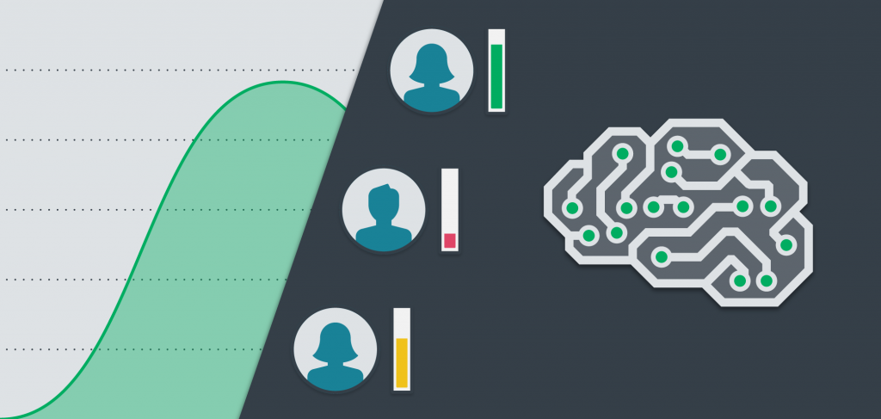
Churn Predictive Modeling
Churn analysis in order to reduce churn and increase profits
Notes:
My proposed solution to the problem of churn would be to perform churn predictive modeling. A churn analysis would be beneficial to the stakeholder as it would allow them to analyze which features amongst the sample set are directly contributing to customer churn, so that they may target those features accordingly. For instance, if a higher age is linked to a higher churn rate, the firm can tweak their marketing strategies to appeal to younger audiences- reduce churn- and increase profits. Feature importance is also a technique I’d like to employ to identify how significant each feature is at predicting churn.

Slide 7
The Data

Slide 8

The Data
‘Bank Customer Churn Prediction.csv’
Stakeholder: ABC Multistate Bank
Notes:
The Bank Customer Churn dataset was obtained from Kaggle. It is stored in a CSV file, titled ‘Bank Customer Churn Dataset’. The dataset contains 10,000 sample points from ABS Multistate Bank. It consisted of 12 distinct features those being customer_id, credit_score, country, gender, age, tenure, balance, products_number, credit_card, active member, estimated salary, and churn.

Slide 9
The Approach

Slide 10
The Approach
Select Dataset
Data Preprocessing
Exploratory Data Analysis
Data Fitting
Determine the most accurate algorithm
Feature Plotting
Analysis of Results

Slide 11
Graphical Modeling

Slide 12
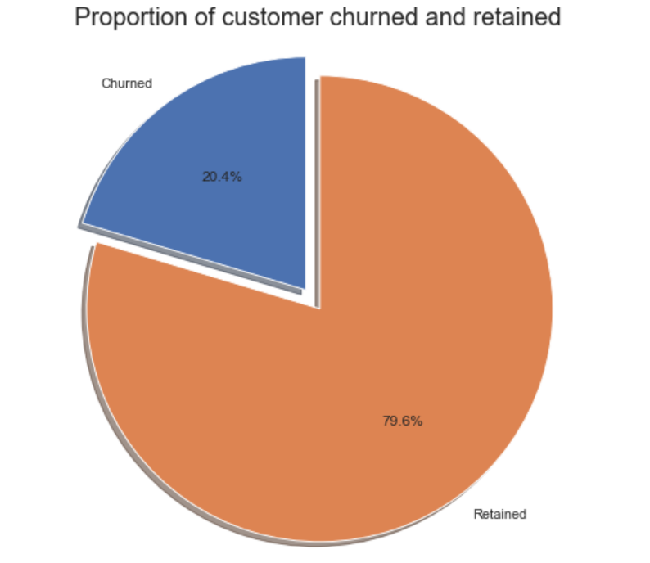
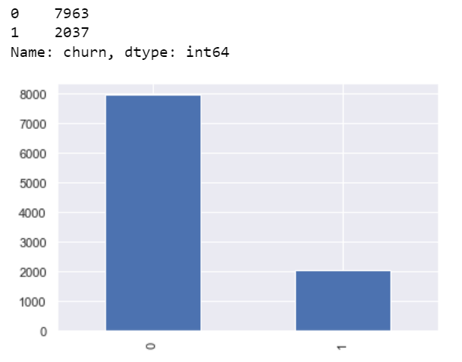
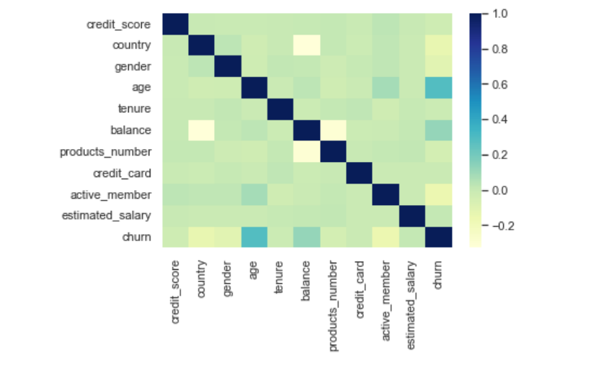
Graphical Models
Notes:
For the graphical modeling aspect of my project, I first created a basic visualization to count the churned observations in the dataset which revealed that A total of 2037 customers churned. I also created a pie chart representation. And as you can see in the pie chart- about 20% of the customers have churned. So the baseline model could be to predict that 20% of the customers will churn. Given 20% is a small number, we need to ensure that the chosen model does predict with great accuracy this 20% as it is of interest to the bank to identify and keep this bunch as opposed to accurately predicting the customers that are retained.

Slide 13
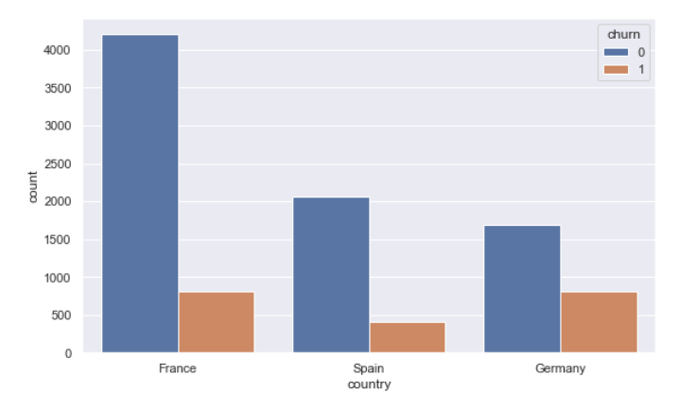
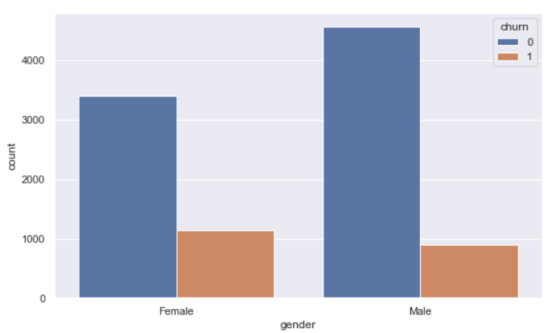
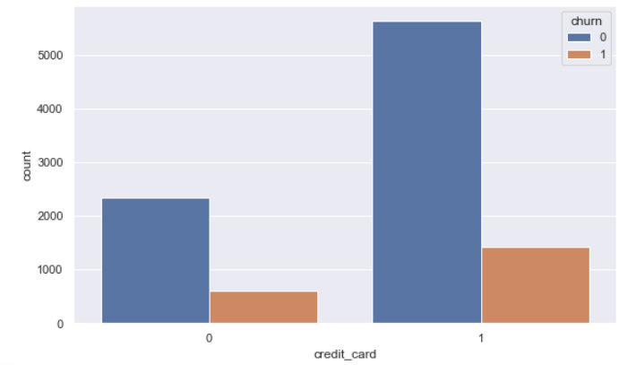
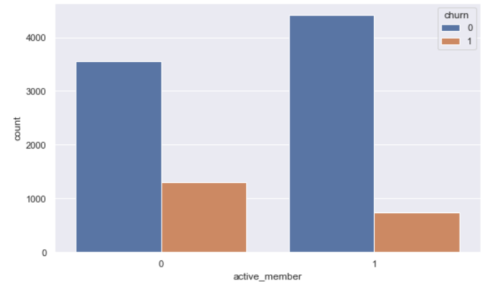
Graphical Models Cont.
Notes:
I constructed a few graphical models of the dataset to study the apparent correlation between each feature and churn outcome. I selected the features of country, gender, credit_card, and active member. In terms of the country feature, Germany had the most churns. For gender, I saw females churning a bit more across the board, and males acted predominantly as retained customers. Customers holding a credit card with the bank were more likely to be retained, as well as active members who the bank was to retain to a large extent.

Slide 14
Machine Learning Modeling

Slide 15
Machine Learning Models
Decision Trees
Accuracy Score: 78.5 %
Random Forest
Accuracy: 86.3%
Notes:
The decision tree model produces a prediction accuracy of 78.5%.

Slide 16
Conclusion
Notes:
I have derived the accuracy scores for the respective ML algorithms, which was indicative of the fact that random forest is the more accurate predictive model.

Slide 17
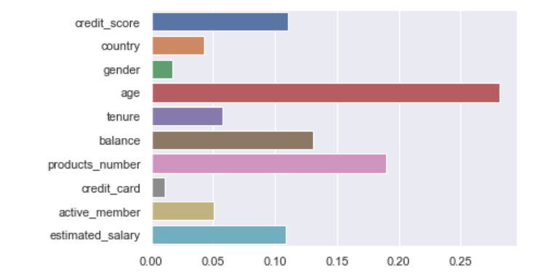
Feature Importance
Notes:
Feature importance provides a list of the variables (features) and their corresponding importance in terms of predicting customer churn. The chart above depicts that age, products_number, and balance are the most prominent features. Age is the most dominant as a predictor. At the second position is “products_number,” which indicates the number of active banking products the customer has with the bank. The possible interpretation is that the more products the customer has, the more engaged with the bank he/she is.

Slide 18
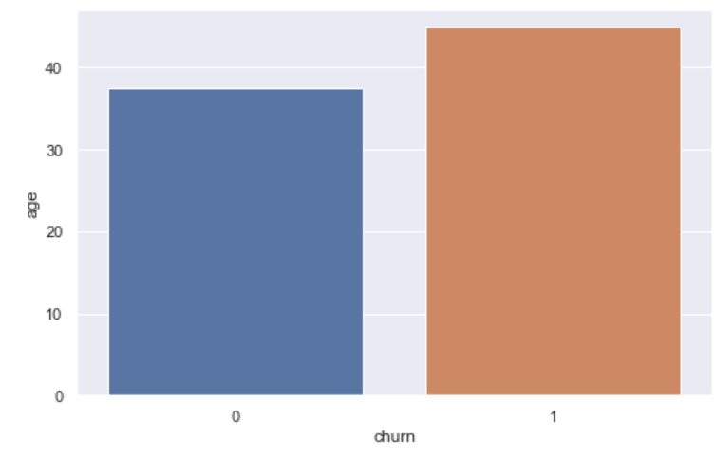
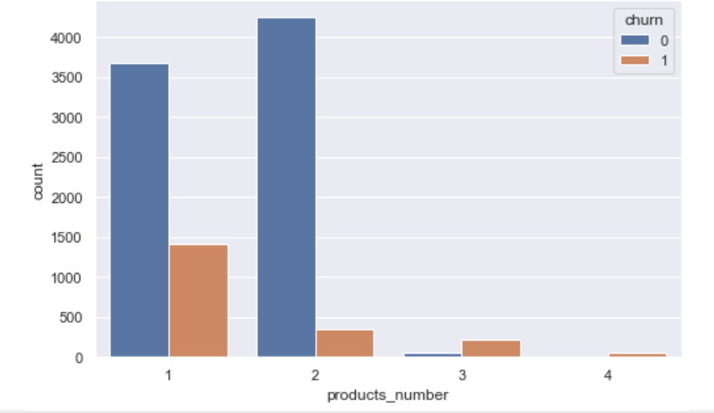
Feature Evaluation
Notes:
The first

Slide 19
Questions?

